Slide 1
Hospital Mangement

Slide 2
Hospital Management Scope
The Hospital Management Database System is designed to manage hospital operations efficiently using a relational database. It stores and organizes information related to departments, doctors, patients, appointments, admissions, treatments, and billing. The database minimizes data redundancy, improves accuracy, and enables quick access to patient and hospital records. It uses primary keys, foreign keys, joins, subqueries, views, and aggregate functions to maintain data integrity and generate meaningful reports. The system supports appointment scheduling, patient treatment, billing management, and hospital analytics, providing a reliable and scalable solution for improving healthcare administration and decision-making processes.

Slide 3
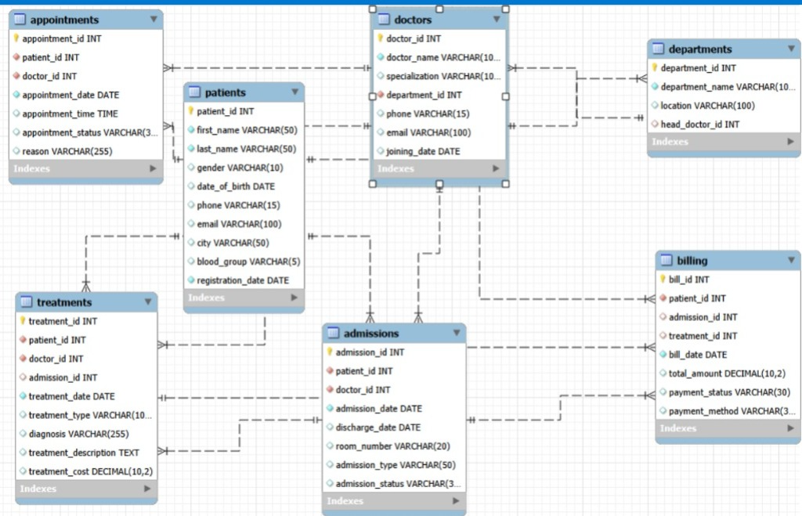
ERR Diagram

Slide 4
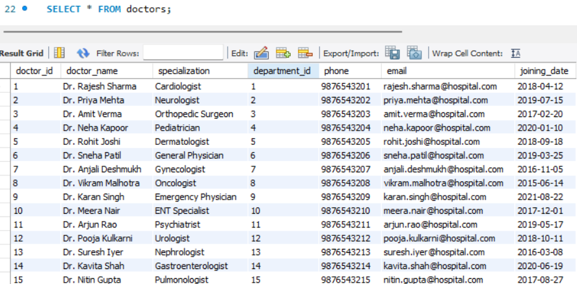
TABLES STRUTURE

Slide 5
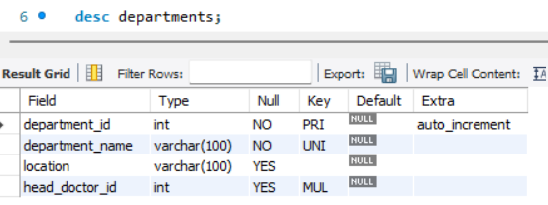
Structure of Department Table
Department table stores hospital department details, including department ID, name, location and assigned head doctor.
Syntax: desc departments;

Slide 6
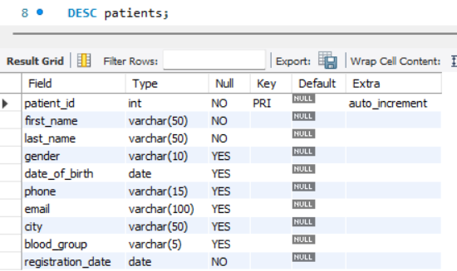
Structure of Patient Table
The Patient table stores patient information, including patient ID, personal details, contact information, gender, age, city, registration date and etc.
Syntax: DESC patients;

Slide 7
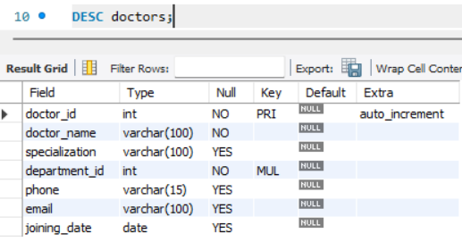
Structure of Doctor Table
The Doctors table stores doctor information including doctor ID, name, specialization, department, contact details and joining date.
Syntax: DESC doctors;

Slide 8
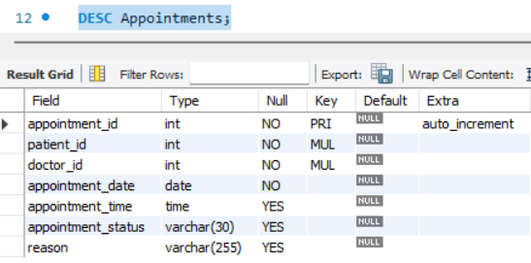
Structure of Appointment Table
The Appointments table stores appointment details including appointment ID, patient ID, doctor ID, appointment date, time, and status.
Syntax: DESC Appointments;

Slide 9
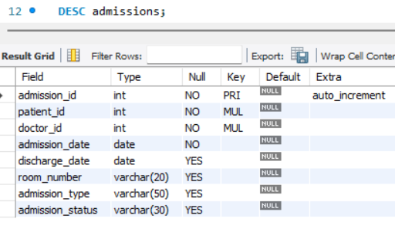
Structure of Admission Table
The Admissions table stores patient admission details including admission ID, patient ID, doctor ID, admission date, discharge date, admission type ,status and room number..
Syntax: DESC admissions;

Slide 10
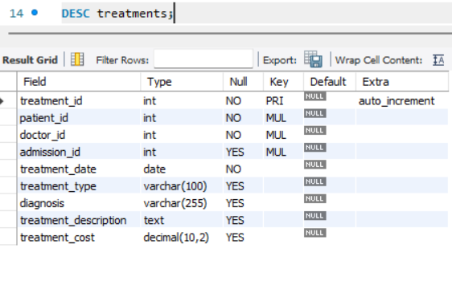
Structure of Treatment Table
The Treatments table stores treatment details including treatment ID, patient ID, doctor ID, admission ID, treatment description, diagnosis, treatment type, treatment cost, and date.
Syntax: DESC treatments;

Slide 11
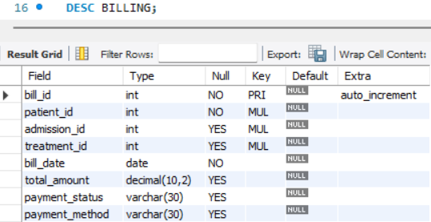
Structure of Billing Table
The Billing table stores billing information including bill ID, patient ID, treatment ID, total amount, payment method, and payment status.
Syntax: DESC BILLING;

Slide 12
TABLES CONTENT

Slide 13
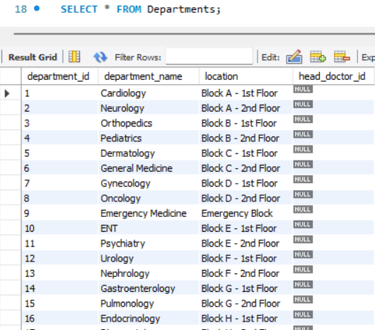
Content of Department Table

Slide 14
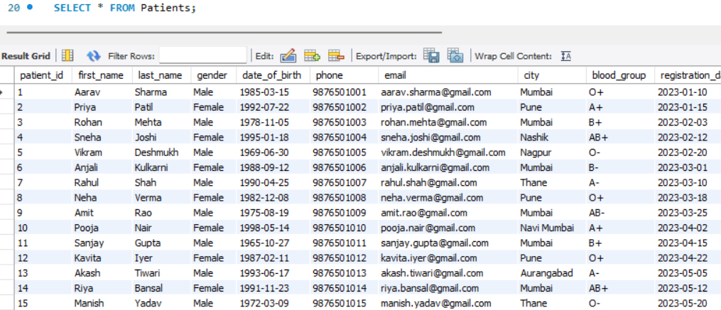
Content of Patient Table

Slide 15
Content of Doctor Table

Slide 16
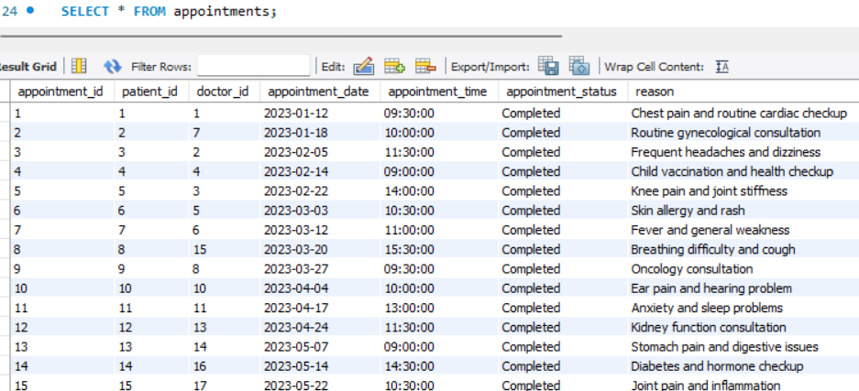
Content of Appointment Table

Slide 17
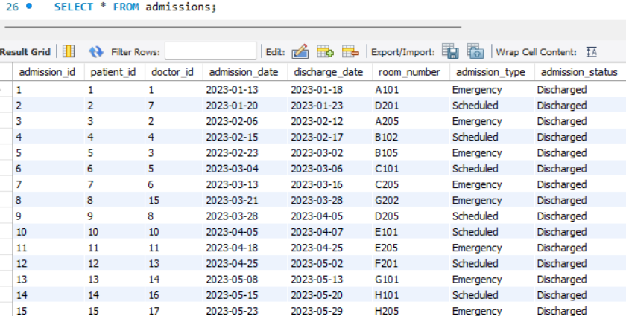
Content of Admission Table

Slide 18
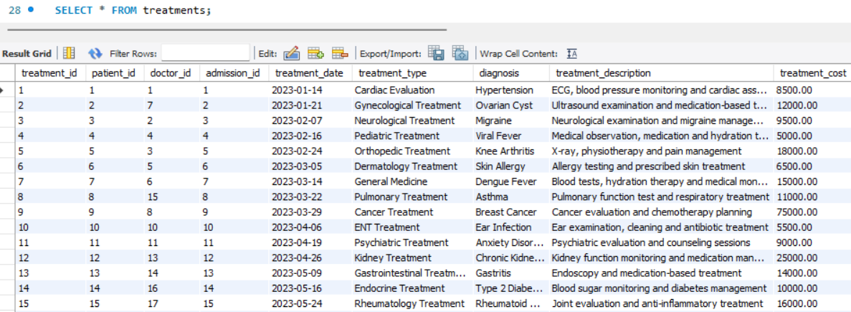
Content of Treatment Table

Slide 19
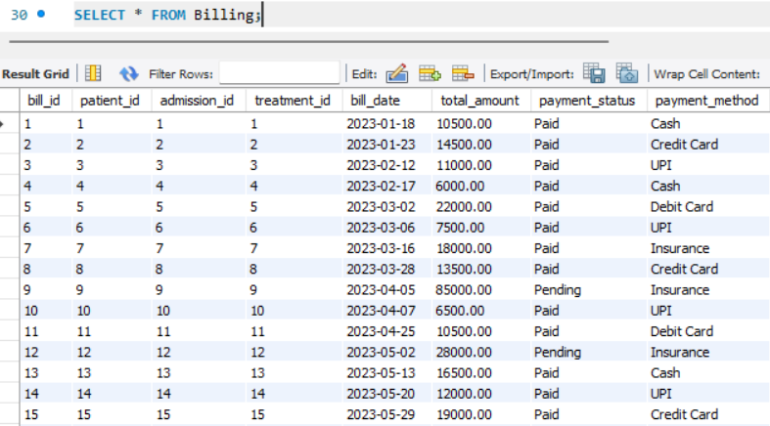
Content of Billing Table

Slide 20
SUBQUIRES

Slide 21
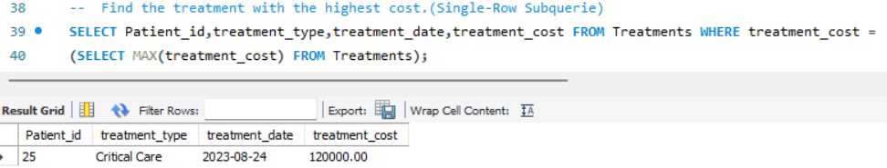
Single-Row Subquery
Find the treatment with the highest cost.
SYNTAX: SELECT Patient_id, treatment_type, treatment_date, treatment_cost FROM Treatments WHERE treatment_cost =(SELECT MAX(treatment_cost) FROM Treatments);

Slide 22
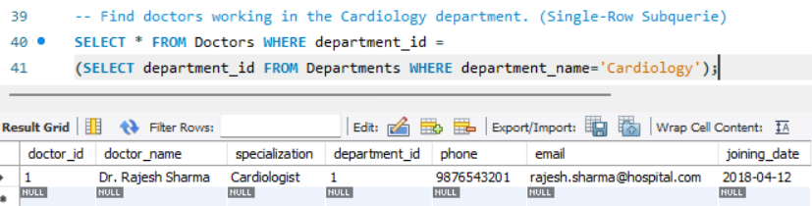
Single-Row Subquery
Find doctors working in the Cardiology department.
SYNTAX: SELECT * FROM Doctors WHERE department_id =(SELECT department_id FROM Departments WHERE department_name='Cardiology');

Slide 23
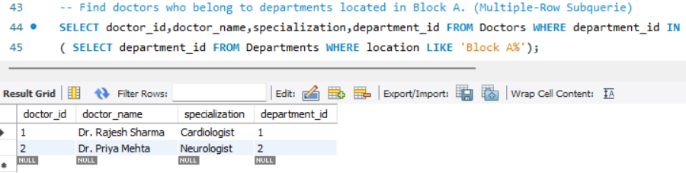
Multi-Row Subquery
Find doctors who belong to departments located in Block A.
SYNTAX: SELECT doctor_id, doctor_name, specialization, department_id FROM Doctors WHERE department_id IN( SELECT department_id FROM Departments WHERE location LIKE 'Block A%');

Slide 24
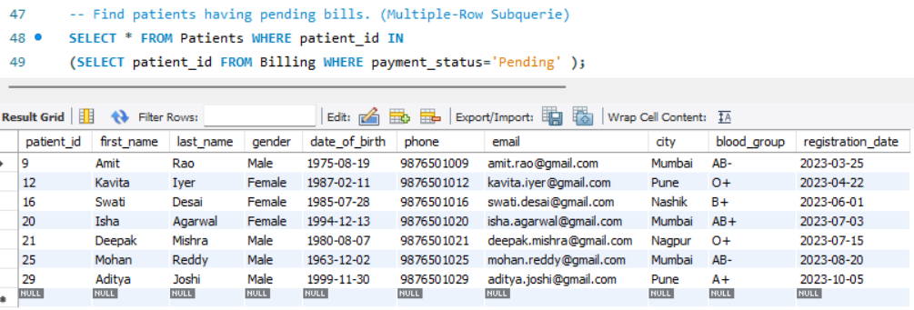
Multi-Row Subquery
Find patients having pending bills.
SYNTAX: SELECT * FROM Patients WHERE patient_id IN(SELECT patient_id FROM Billing WHERE payment_status='Pending' );

Slide 25
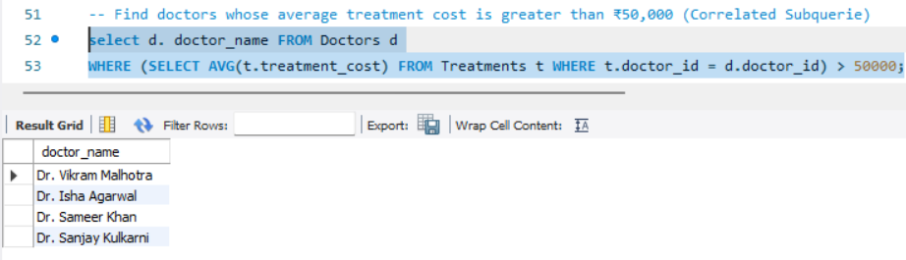
Correlated Subquery
Find doctors whose average treatment cost is greater than ₹50,000 SYNTAX: select d. doctor_name FROM Doctors d WHERE (SELECT AVG(t.treatment_cost) FROM Treatments t WHERE t.doctor_id = d.doctor_id) > 50000;

Slide 26
JOINS

Slide 27
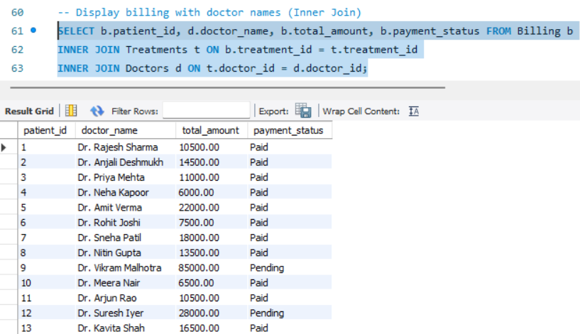
Inner Join
Display billing with doctor names.
SYNTAX: SELECT b.patient_id, d.doctor_name, b.total_amount, b.payment_status FROM Billing b
INNER JOIN Treatments t ON b.treatment_id = t.treatment_id
INNER JOIN Doctors d ON t.doctor_id = d.doctor_id;

Slide 28
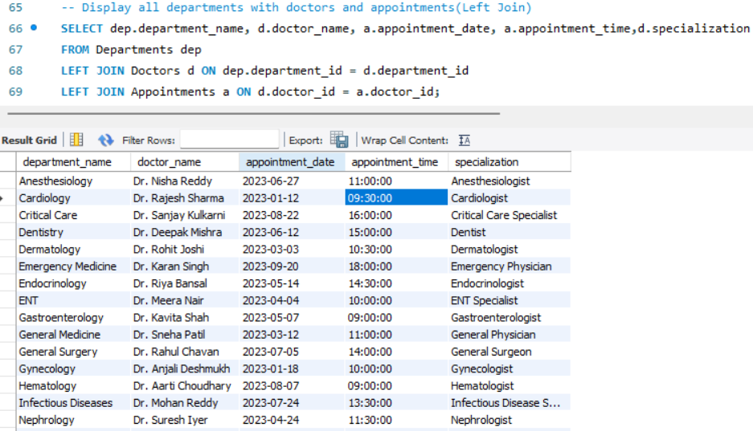
Left Join
Display all departments with doctors and appointments
SYNTAX: SELECT dep.department_name, d.doctor_name, a.appointment_date, a.appointment_time, d.specialization FROM Departments dep
LEFT JOIN Doctors d ON dep.department_id = d.department_id
LEFT JOIN Appointments a ON d.doctor_id = a.doctor_id;

Slide 29
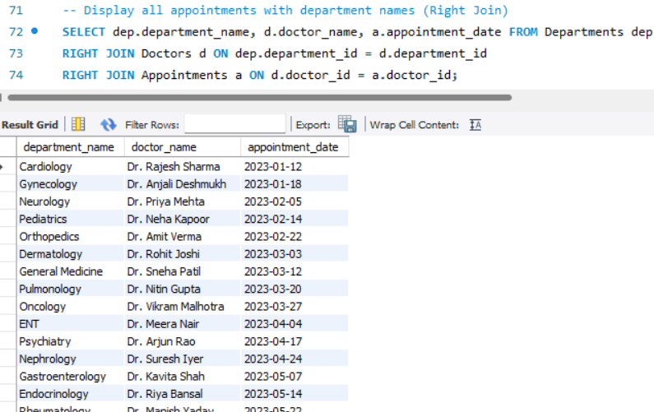
Right Join
Display all appointments with department names
SYNTAX: SELECT dep.department_name, d.doctor_name, a.appointment_date FROM Departments dep
RIGHT JOIN Doctors d ON dep.department_id = d.department_id
RIGHT JOIN Appointments a ON d.doctor_id = a.doctor_id;

Slide 30
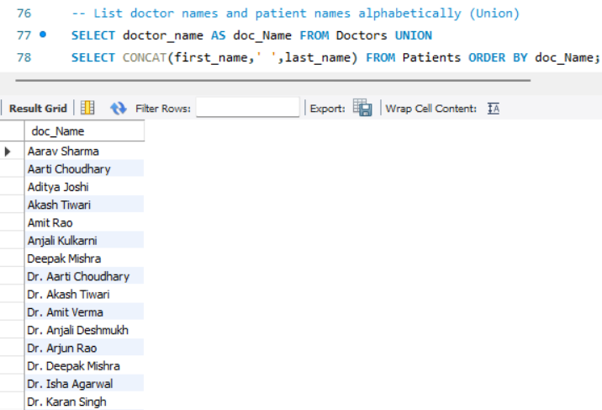
Union Join
List doctor names and patient names alphabetically
SYNTAX SELECT doctor_name AS doc_Name FROM Doctors
UNION
SELECT CONCAT(first_name,' ',last_name) FROM Patients ORDER BY doc_Name;

Slide 31
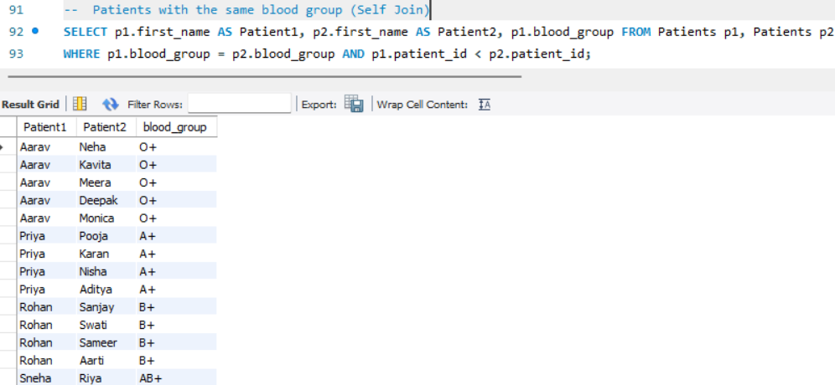
Self Join
Patients with the same blood group
SYNTAX : SELECT p1.first_name AS Patient1, p2.first_name AS Patient2, p1.blood_group FROM Patients p1, Patients p2
WHERE p1.blood_group = p2.blood_group AND p1.patient_id < p2.patient_id;

Slide 32
VIEWS

Slide 33
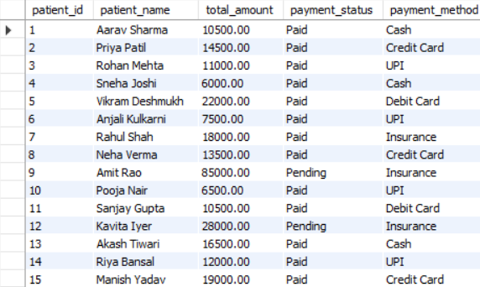
VIEWS
Patient Billing View
SYNTAX : CREATE VIEW Patient_Billing_View AS
SELECT p.patient_id, CONCAT(p.first_name,’ ',p.last_name) AS patient_name, b.total_amount, b.payment_status, b.payment_method FROM Patients p
JOIN Billing b ON p.patient_id = b.patient_id;

Slide 34
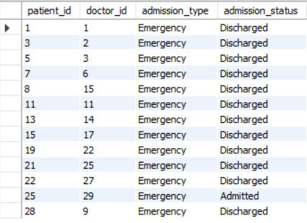
VIEWS
Emergency Admissions View
SYNTAX : CREATE VIEW Emergency_Admissions AS
SELECT patient_id, doctor_id, admission_type, admission_status FROM Admissions WHERE admission_type='Emergency';

Slide 35
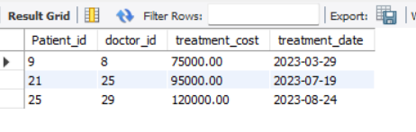
VIEWS
High Cost Treatments View
SYNTAX : CREATE VIEW High_Cost_Treatments AS
SELECT Patient_id, doctor_id, treatment_cost, treatment_date FROM Treatments WHERE treatment_cost > 60000;

Slide 36
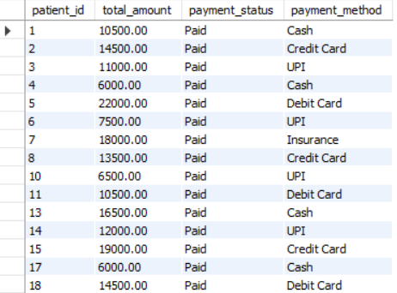
VIEWS
Paid Bills View
SYNTAX : CREATE VIEW Paid_Bills AS
SELECT patient_id, total_amount, payment_status, payment_method FROM Billing WHERE payment_status='Paid';

Slide 37
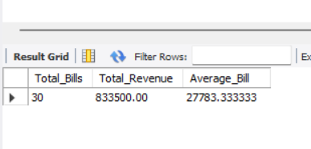
VIEWS
Total Hospital Billing Summary
SYNTAX : CREATE VIEW Hospital_Billing_Summary AS
SELECT COUNT(*) AS Total_Bills, SUM(total_amount) AS Total_Revenue, AVG(total_amount) AS Average_Bill FROM Billing;

Slide 38

Prepared By :
Sanket Ratilal Shirsath
IT Vedant
T380/DSA/11AM-1PM

Slide 39
Thank You

